Slide 1
Grade the Globe
Martina Garate, Sarah Whynott, and Emma Kryza
Notes:
Hello everyone! We are Martina, Sarah, and Emma and our project is called Grade the Globe.

Slide 2


The Problem
Student 1 (planning on going abroad)
Student 2 (already went abroad)
“I’m studying abroad in Italy next semester, but I’ve never even been outside of the United States! How will I know where to eat, stay, visit, and go out? I don’t want to bother my friends by asking them for tips. If only there was a simple way to ask for their recommendations.”
“My best friend at Villanova is going to Spain next year. I want to tell him about an amazing restaurant that I went to when I was abroad, but I completely forgot the name and what I ordered! I wish that it was easier to keep track of my recs and share them with him”
Notes:
We created these two students to exemplify our inspiration for the project. Student 1 says *READ BUBBLE*. Student 2 says *READ BUBBLE* So what is our solution to these two needs?

Slide 3

The Solution
A website of personalized profiles containing hotel, restaurant, museum, and bar recommendations rated on a 5-star scale.
GR
DE
-T H E-
G L
BE
Notes:
Grade the Globe! A website of personalized profiles containing hotel, restaurant, museum, and bar recommendations rated on a 5-star scale

Slide 4
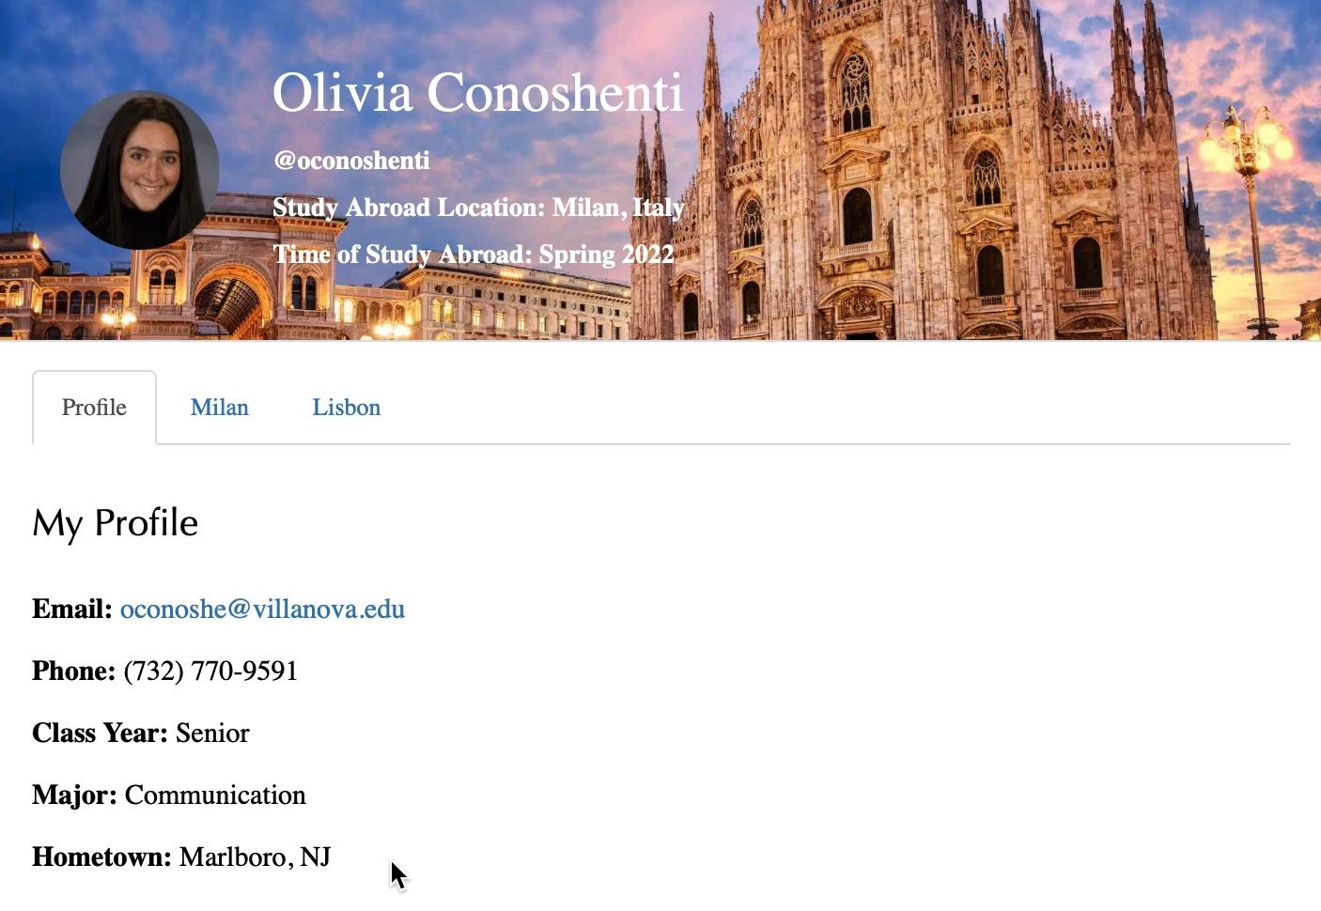
The Result
Notes:
This is what a Grade the Globe profile might look like. At the top we have a personalized profile picture and banner photo as well as username, study abroad location, and time of study abroad. On our profile tab, we have basic contact information like email and phone number and then the student’s class year, major, and hometown. As you can see, each city has a separate tab and on each of these tabs is the list of their recommendations. They each have a rating out of 5 stars and a short description.

Slide 5
Thank You!
Come by our poster with questions or for additional information.
Notes:
Thank you all! Feel free to come by our poster for any questions or to learn more about Grade the Globe!

